Slide 1
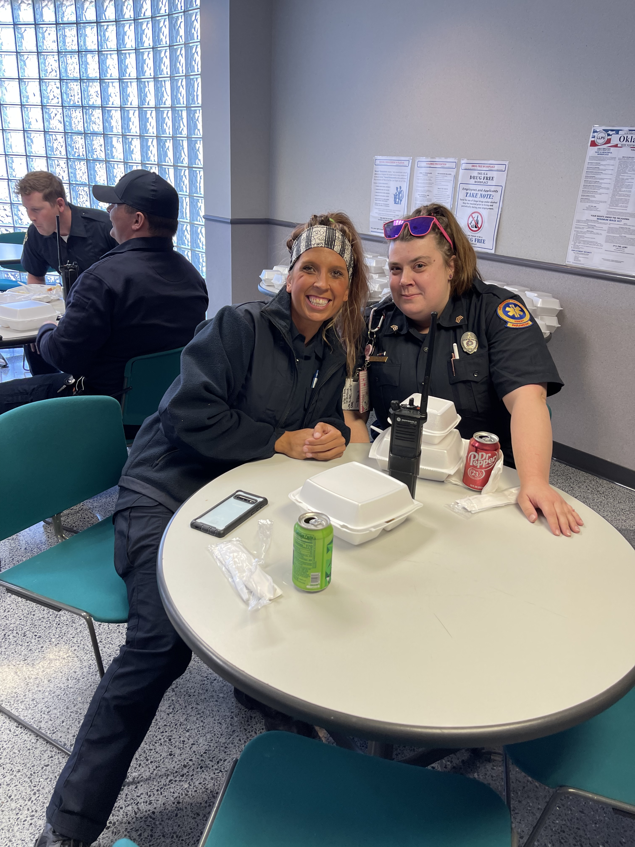
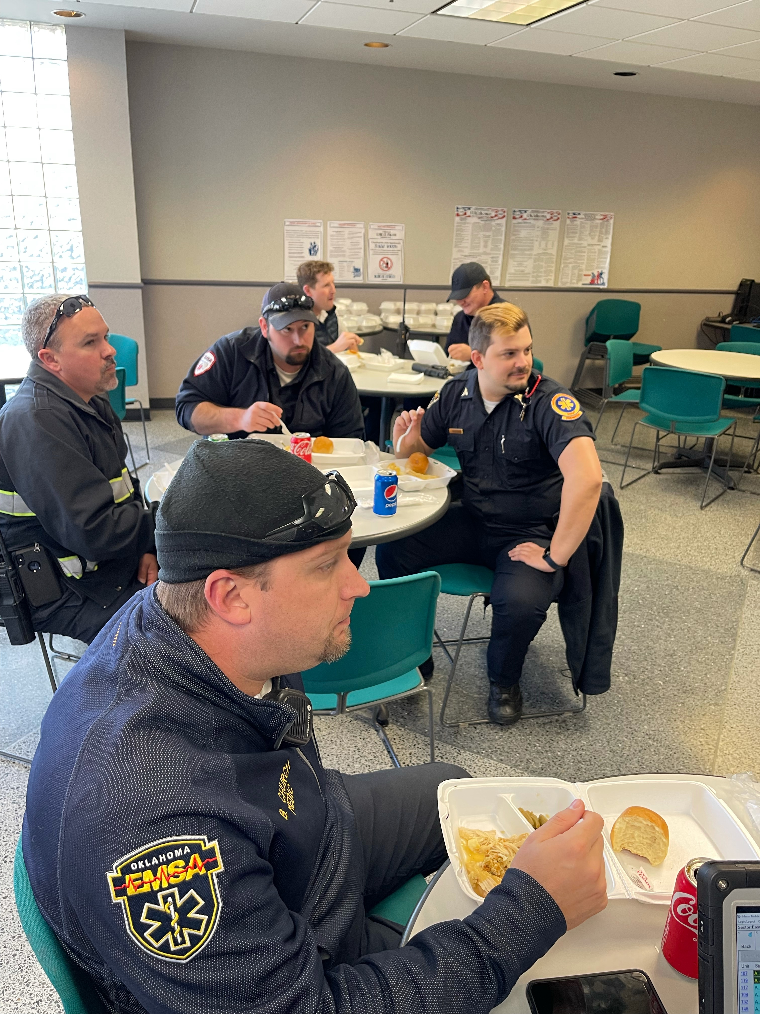
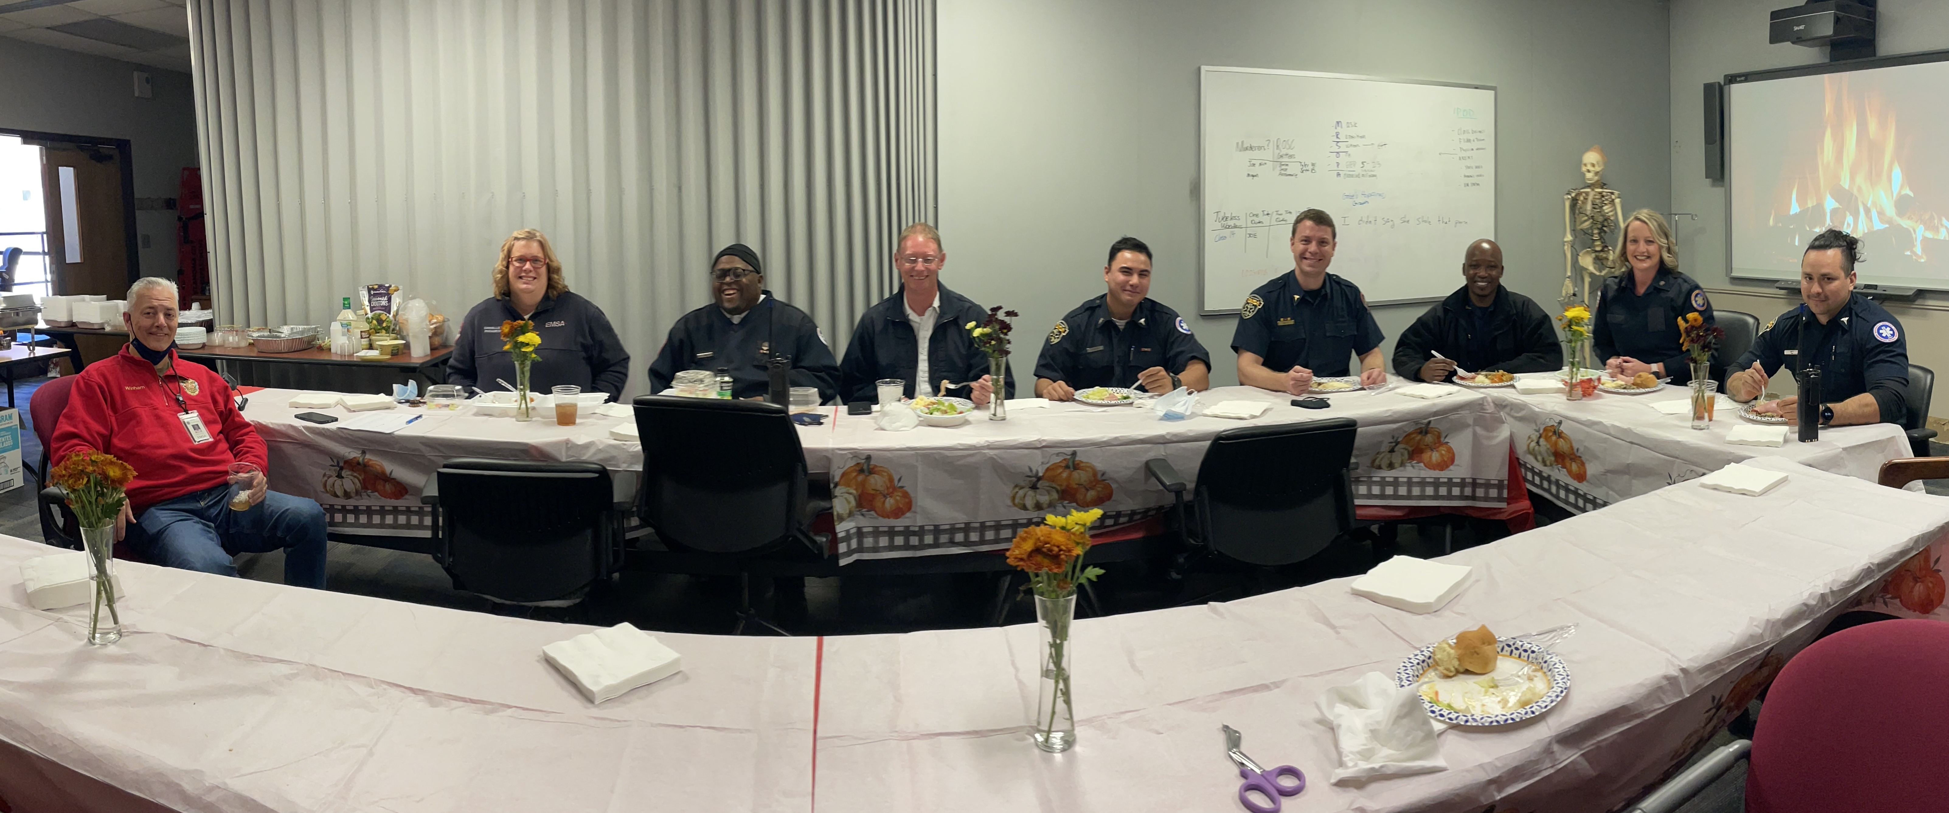

Slide 2
Key Performance Indicators November 2021
Adam Paluka
Chief Public Affairs Officer

Slide 3
