Slide 1
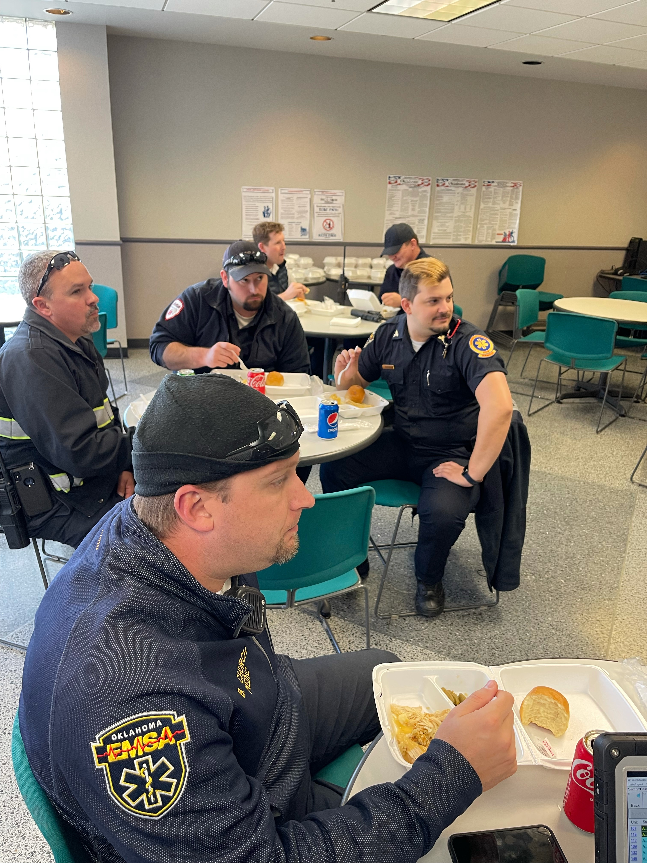

Slide 2
Financial Report November 2021
Lora Conger
Chief Financial Officer

Slide 3
EMSA FY22 Income Statement
 | Year to date as of Oct-2021
 | Actuals | Budget 2022 | Variance
Revenue
Net Patient Revenue
Patient Revenue | 85,393,186 | 76,647,749 | 8,745,437
Contractuals & Deductions | (62,971,346) | (55,136,598) | (7,834,748)
Total Net Patient Revenue | 22,421,839 | 21,511,150 | 910,689
Realization Rate | 26.3% | 28.1%
Other Operating Revenue | 3,981,299 | 4,098,000 | (116,701)
Total Revenue | 26,403,139 | 25,609,150 | 793,988
Total Operating Expense | 21,699,272 | 21,995,475 | (296,203)
Non-Operating Income | 27,227 | 32,000 | (4,773)
Non-Operating Expenses | 1,234,652 | 1,236,000 | 1,348
Net Income | 3,496,442 | 2,409,675 | 1,086,766
Net Income % | 13.2% | 9.4%

Slide 4
Trending Graphs

Slide 5
EMSA FY22 Operating Expenses
 | Year to date as of Oct-2021
 | Actuals | Budget 2022 | Variance
Expense
Salary & Wages | 12,766,859 | 12,668,696 | (98,164)
Benefits | 3,064,441 | 3,029,840 | (34,601)
Professional & Contracted Services | 950,639 | 926,835 | (23,804)
Training & Development | 51,583 | 87,186 | 35,602
Supplies | 2,045,913 | 2,096,750 | 50,837
Repairs & Maintenance | 962,725 | 902,823 | (59,902)
Utilities | 509,724 | 421,510 | (88,214)
Rent | 202,927 | 199,829 | (3,098)
Risk Management | 407,681 | 940,178 | 532,497
Public Relations | 48,746 | 40,656 | (8,090)
Other Expenses | 688,034 | 681,173 | (6,861)
Total Operating Expense | 21,699,272 | 21,995,475 | 296,202

