Slide 1
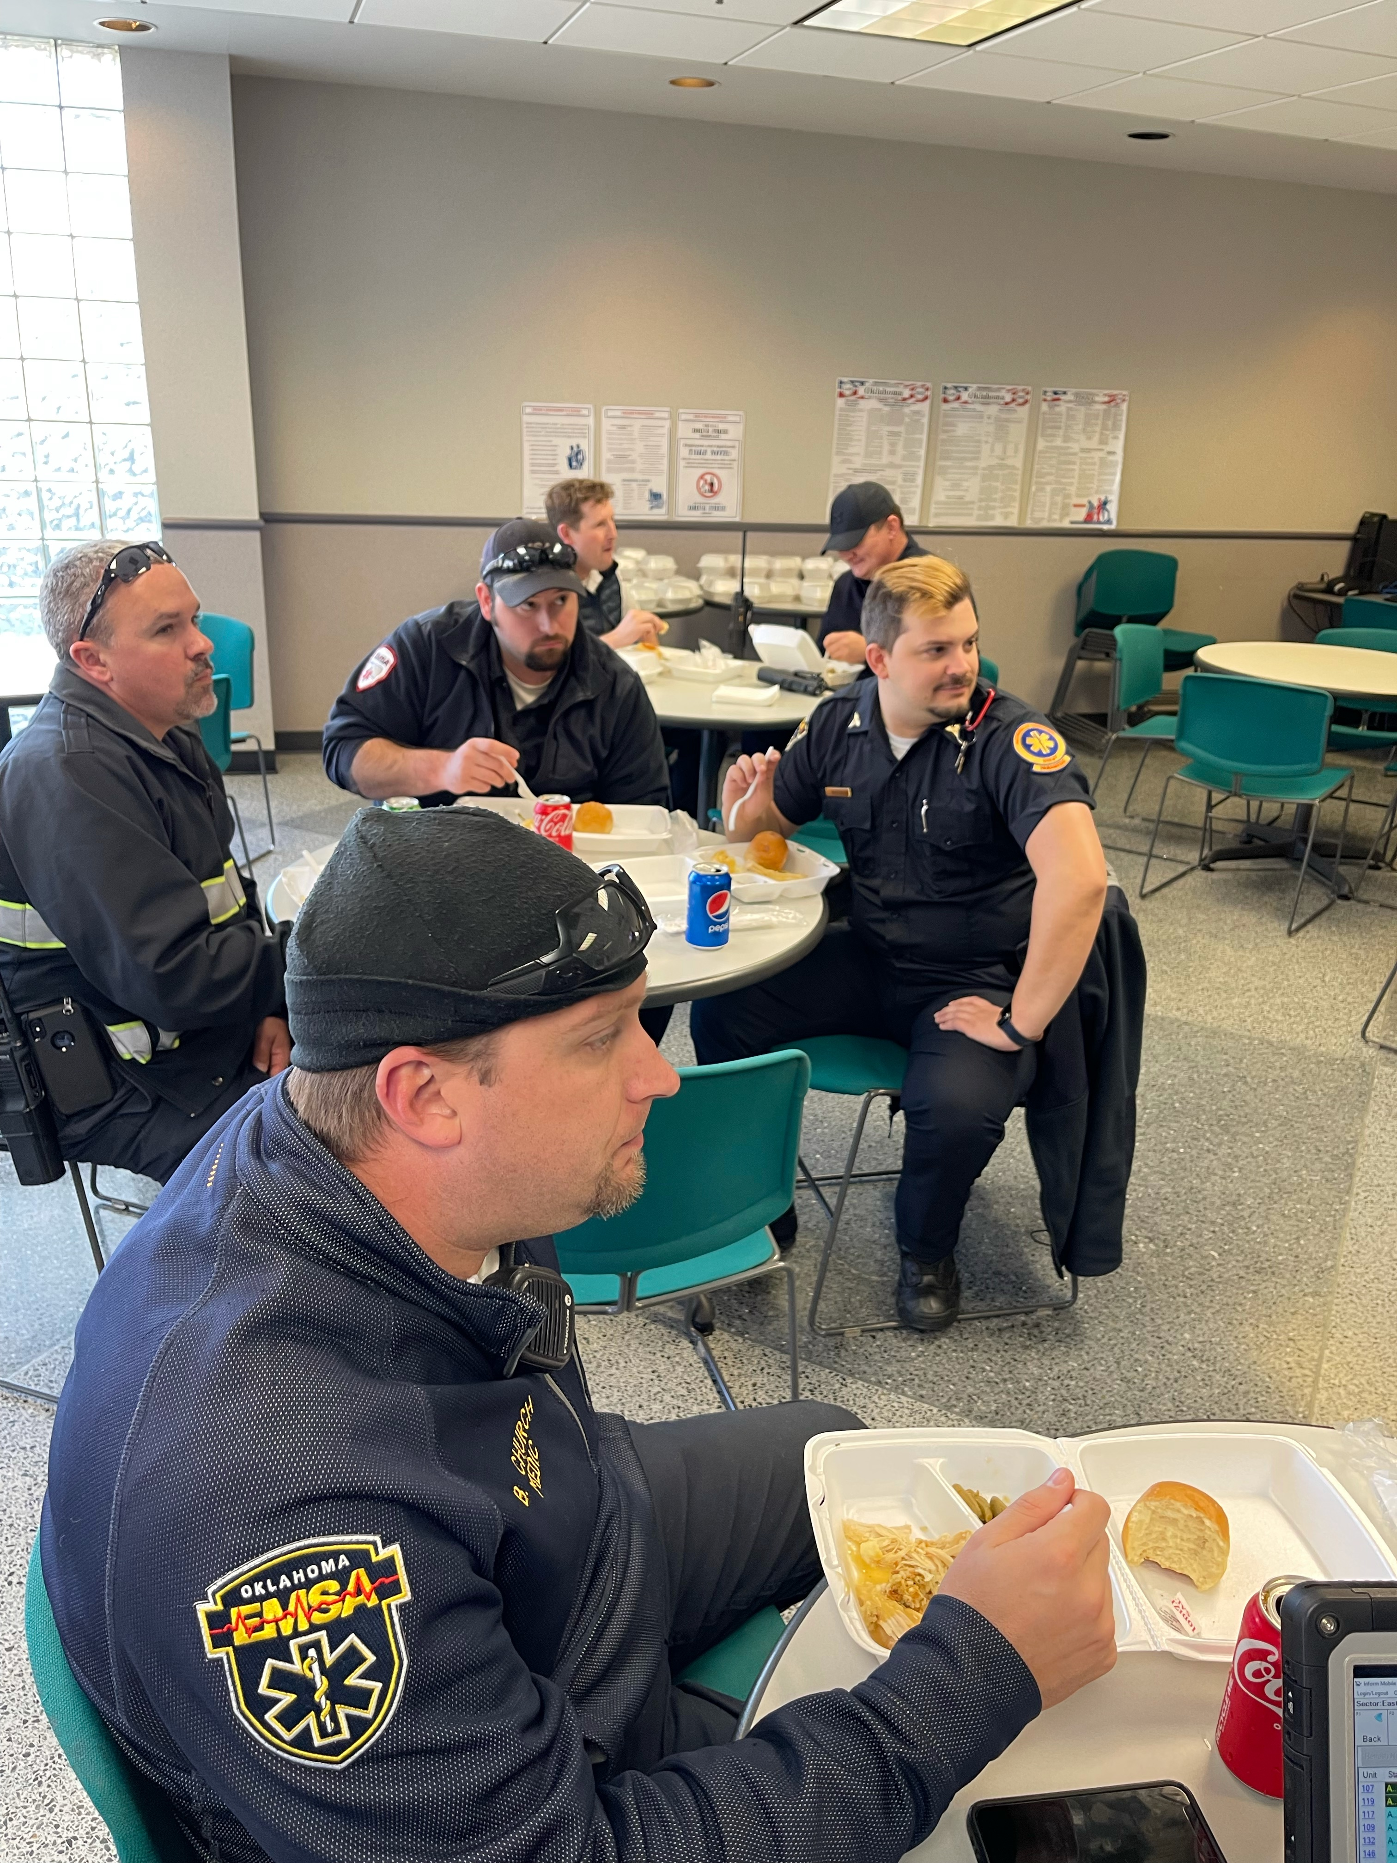

Slide 2
Operational Compliance Report November 2021
Frank Gresh
Chief Information Officer

Slide 3
November 2021 Compliance Summary – Combined
 | Priority 1 | Priority 2 | Priority 3 | Priority 4
East Ben. Total | 88% | 92% | 71% | 93%
East NB Total | Priority 1&2 | 75% | 100% | N/A
West Ben. Total | 56% | 80% | 51% | 44%
West NB Total | Priority 1&2 | 57% | 33% | N/A

Slide 6
Exclusions

Slide 7
Exclusions

